Slide 1
Global Retail
Sales Analysis

Slide 2

Global Retail
Agenda
01.
Data Understanding
02.
Data_Cleaning
03.
Data_Modeling
04.
Product_Analysis
05.
Customer Analysis
06.
Store & Sales Analysis
07.
Financial Analysis
08.
Executive Dashboard & KPI Analysis

Slide 3
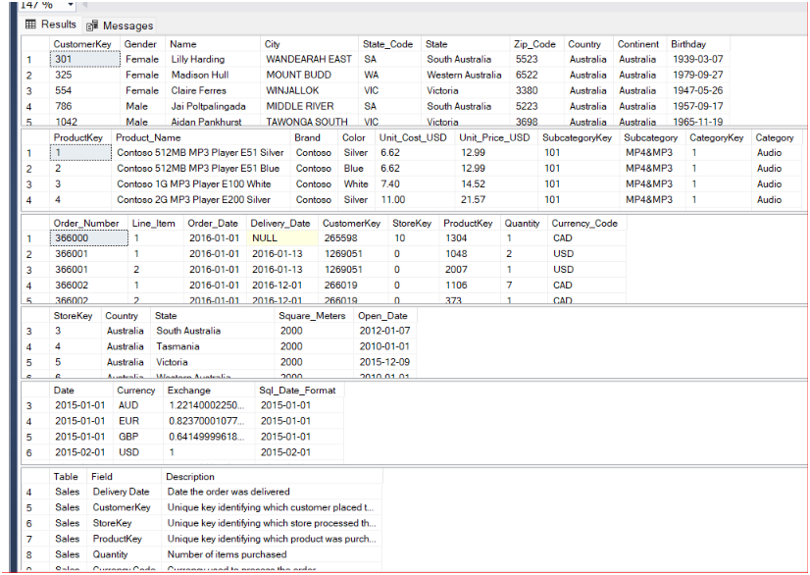
Global retail
Data Understanding
SELECT * FROM Customers;
SELECT * FROM Products;
SELECT * FROM Sales;
SELECT * FROM Stores;
SELECT * FROM Exchange_Rates;
SELECT * FROM Data_Dictionary;

Slide 4
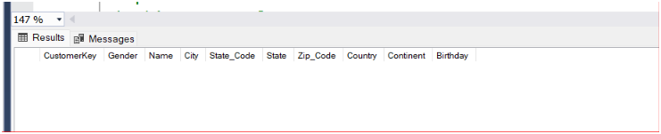
Global retail
DATA VALIDATION
Checking NULL Values in
Customers Table
SELECT *
FROM Customers
WHERE CustomerKey IS NULL
OR Name IS NULL
OR Gender IS NULL
OR City IS NULL
OR State_Code IS NULL
OR State IS NULL
OR Zip_Code IS NULL
OR Country IS NULL
OR Continent IS NULL
OR Birthday IS NULL;

Slide 5
Global retail
Data Cleaning
-- Data Type Validation
-- ZIP Code Validation
-- NULL Handling
-- Missing Value Verification
-- Duplicate Validation
-- Exchange Rate Validation
-- Date Format Validation
--No major data cleaning was required because the dataset was already structured.

Slide 6
Global retail
Data Modeling
Fact Table – Sales
Reason for selecting Sales as the Fact Table:
Stores every sales transaction (one record per order).
Contains measurable business metrics such as Quantity, Revenue, and Order Details.
Connects all business entities using CustomerKey, ProductKey, and StoreKey.
Acts as the central table for business analyses.
Used to calculate KPIs such as Revenue, Profit, Orders, and Sales Trends.
Dimension Tables
Customers
Provides customer information for customer behavior and segmentation analysis.
Products
Provides product attributes (Category, Brand, Cost, Price) for product performance and profitability analysis.
Stores
Provides store location details for store performance and delivery analysis.
Exchange_Rates
Provides currency conversion rates to calculate revenue in local currency for global sales analysis.

Slide 7
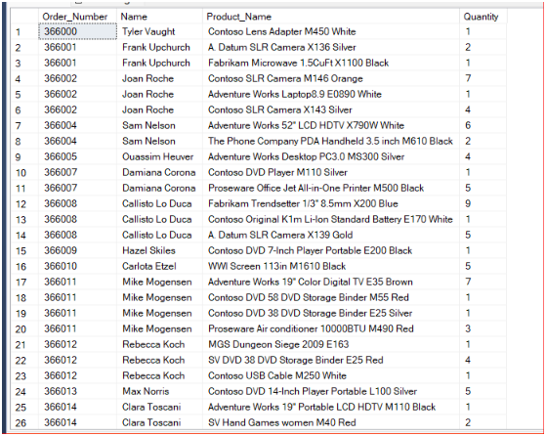
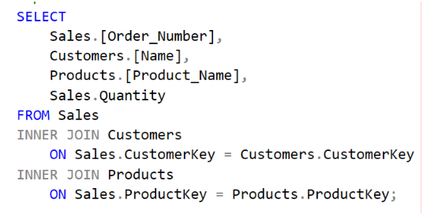
Global retail
Customer Analysis
Write a query to display every sales order along with the corresponding customer name, product name, and quantity purchased.

Slide 8
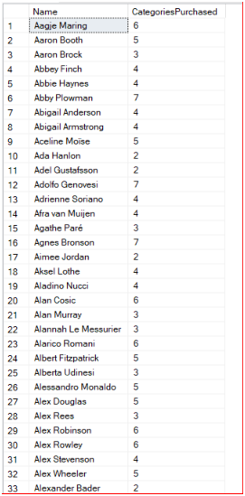
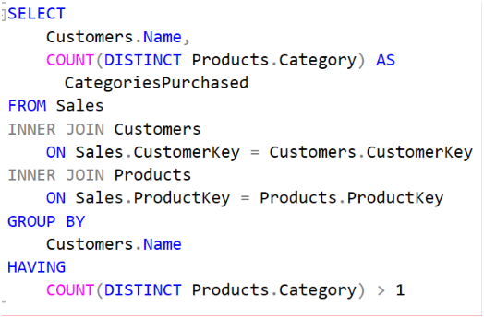
Global retail
Customer Analysis
Write a query to identify customers who have purchased products from more than one product category.

Slide 9
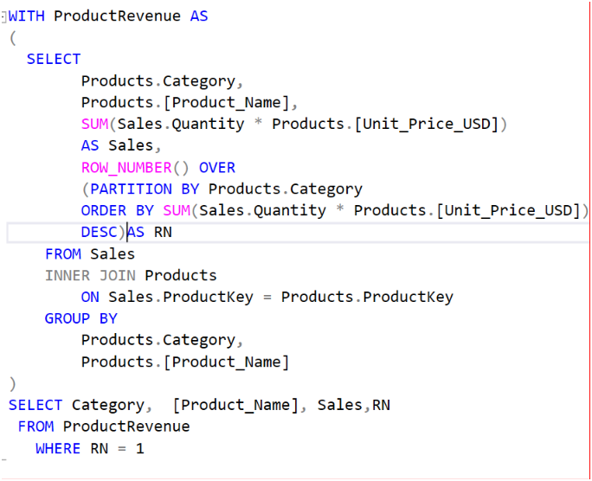
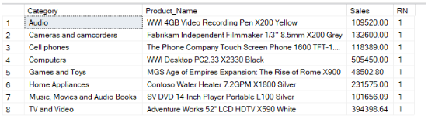
Global retail
Product Analysis
Write a query to find the best-selling product (by revenue) within each product category.

Slide 10
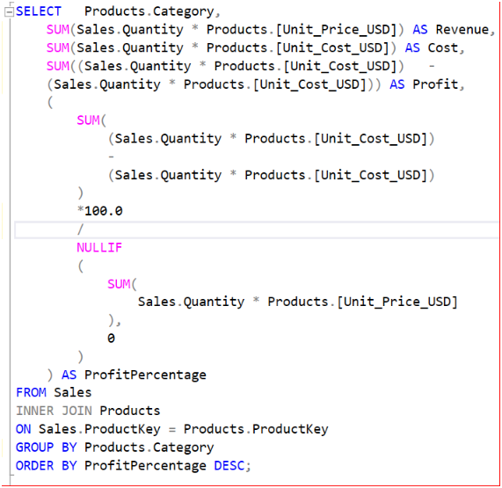
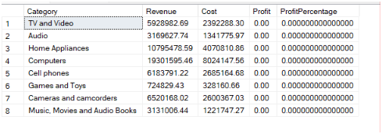
Global retail
Product Analysis
Finance wants to know which product categories generate the highest profit margin. Write a query to display category, revenue, cost, profit, and profit percentage, sorted by profit percentage in descending order.

Slide 11
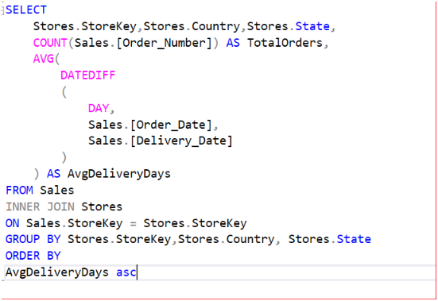
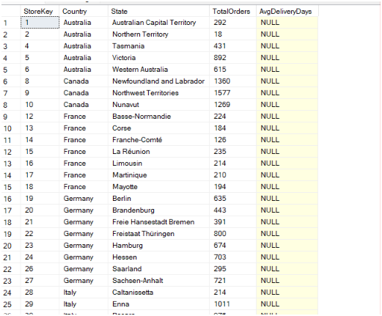
Global retail
Store Analysis
The Operations Manager wants to identify which stores consistently deliver orders the fastest. Write a query to display store key, country, state, total orders, and average delivery days, sorted by fastest delivery time.

Slide 12
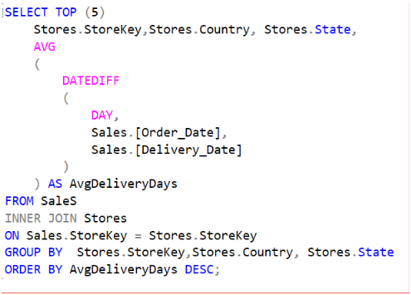
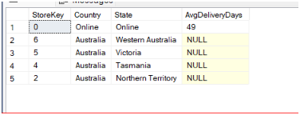
Global retail
Store Analysis
Management wants to investigate stores with poor delivery performance. Write a query to display the top 5 stores with the highest average delivery days.

Slide 13
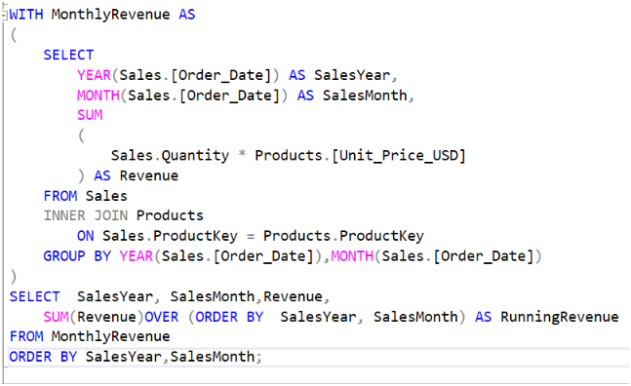
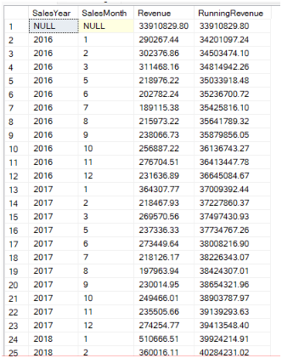
Global retail
Sales Analysis
The CEO wants to track cumulative revenue throughout the year. Write a query to display year, month, monthly revenue, and running (cumulative) revenue.

Slide 14
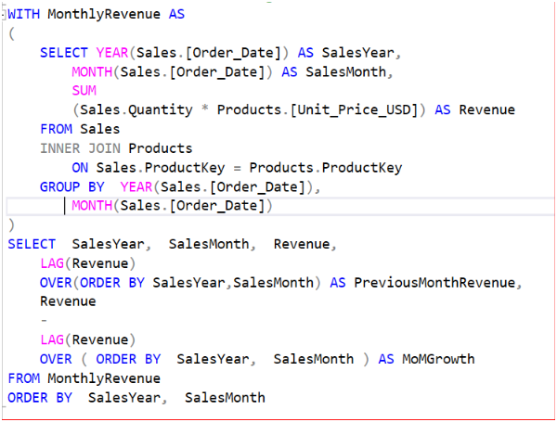
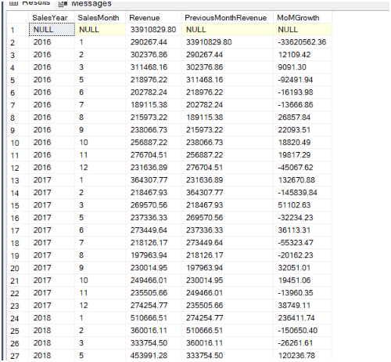
Global retail
Sales Analysis
Management wants to compare each month's revenue with the previous month. Write a query to display year, month, current month revenue, previous month revenue, and month-over-month growth.

Slide 15
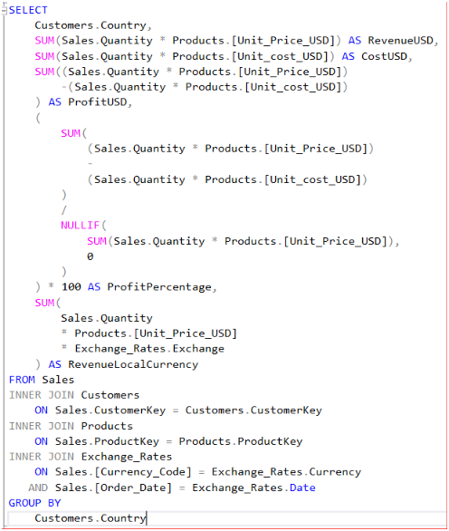
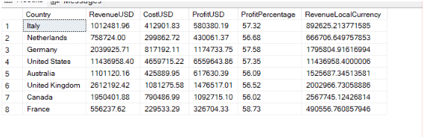
Global retail
Profit Analysis
Write a query to calculate revenue, cost, profit, profit percentage, and revenue in local currency for each country.

Slide 16
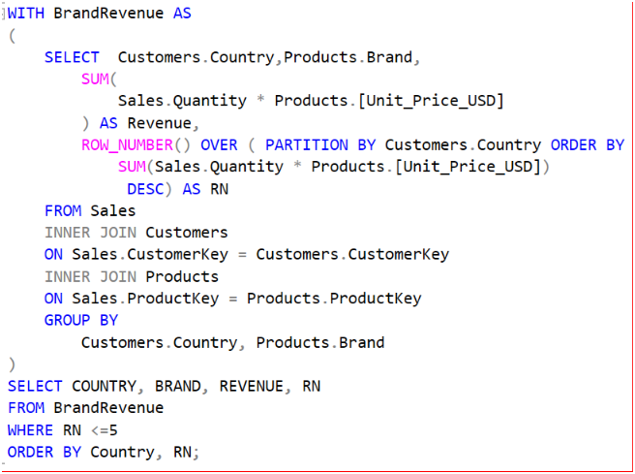
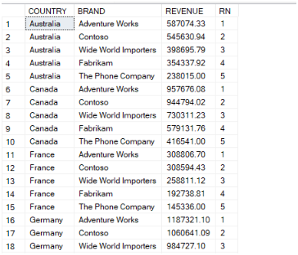
Global retail
Executive Analysis
Marketing wants to know which brands dominate each country. Write a query to display the top 5 brands (by revenue) within each country, along with their rank.

Slide 17
KPI CARD
Sales Performance Overview
55755479.59
26326
2117.8864
31798221.30
Total Revenue
Total Orders
Average Order Value
Total Profit

Slide 18




Global Retail
Key Findings
01.
02.
03.
04.
Revenue increased compared to the previous period.
Several regions demonstrated significant market potential.
Digital sales channels delivered the highest performance.
Top-selling products continued to drive growth.

Slide 19




Global Retails
Action Items
01.
02.
03.
04.
Strengthen customer retention initiatives.
Expand marketing activities in high-growth regions.
Optimize product inventory planning.
Improve performance monitoring across sales channels.

Slide 20
Presented by:
Rohini Kanakala
Global Retail
Thank You
20
20 July, 2026

